Slide 1
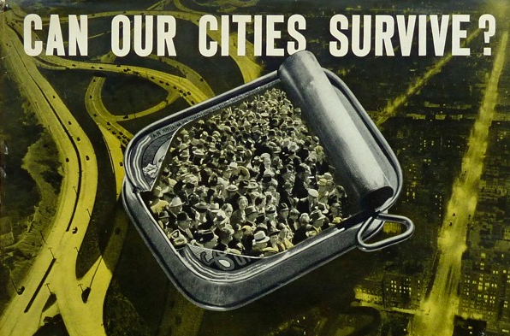
2.0
Migration and Integration in the European Metropolis
Science, Policy & Society Seminar
Brussels | 18 December 2014
Greater Birmingham West Midlands Brussels Office | Avenue d'Auderghem 22-28
Free admission | Information & Registration: brusselsevent2014@gmail.com | canourcitiessurvive.weebly.com

Slide 2
Can our cities survive 2.0? Migration and integration in the European metropolis
Brussels | 18 December 2014
Greater Birmingham West Midlands Brussels Office | Avenue d'Auderghem 22-28
Programme
11.00 - 11.15 Introduction by Stefan Couperus
11.15 - 12.30 Keynote address
Mustafa Dikeç, Professor of Human Geography at Institut français d'urbanisme (IFU)
12.30 - 13.30 Lunch
13.30 - 14.30 Panel I: Diversity and Democracy (chaired by Harm Kaal)
Ana Feder, Policy Advisor at Eurocities
Mashuq Ally, Head of Equalities and Social Cohesion at Birmingham City Council
14.30 - 15.00 Tea break
15.00 - 16.00 Panel II: Migration and Employment (chaired by Jelle van Lottum)
Claire Dhéret, Senior Policy Analyst at European Policy Centre
Hakan Forsell, Urban Historian at Stockholm University
16.00 – 17.30 Wrap up and drinks

