Slide 1
Can our cities survive 2.0? Migration and integration inthe European metropolis
Brussels
18 December 2014
Panel I: Diversity and Democracy
A case study from Integrating Cities
Ana Feder
EUROCITIES

Slide 2
About EUROCITIES
Integrating Cities process
Examples
Current debates

Slide 3
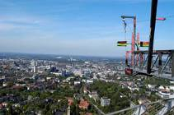
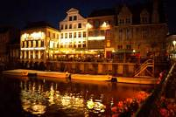
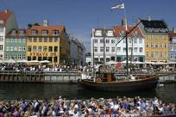
About EUROCITIES
Founded in 1986, representing cities of over 250,000 inhabitants
Over 130 full members in 35 countries, representing 130m citizens
Working on urban priorities across sectors
6 thematic fora, +40 working groups

Slide 5
33 signatory cities +
Amsterdam
Athens
Barcelona
Belfast
Berlin
Brussels
Copenhagen
Dublin
Genoa
Ghent
Helsinki
Leipzig
Lisbon
London
Madrid
Malmö
Manchester
Montpellier
Milan
Munich
Nantes
Oulu
Oslo
Paris
Rennes
Riga
Rome
Rotterdam
Stockholm
Tampere
The Hague
Toulouse
Utrecht

Slide 6
4 areas of city government responsibility:
Cities as policy-makers
Cities as service providers
Cities as employers
Cities as buyers of goods and services
11 commitments on diversity and non-discrimination
Commitment to report

Slide 8
Cities as policy-makers

Slide 9
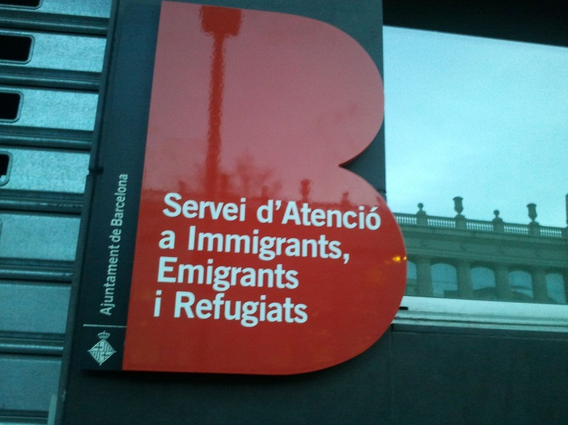
Cities as service providers

Slide 10
Cities as employers

Slide 11
Cities as buyers of goods and service

Slide 12
Trends and debates
comprehensive approach to migrant integration
priorities:
Anti-discrimination
Education
Language acquisition…
external influencing factors:
Demographic change
Economic situation
National/EU developments

Slide 13
More information at:
www.integratingcities.eu
www.eurocities.eu
Ana.feder@eurocities.eu

